Slide 1
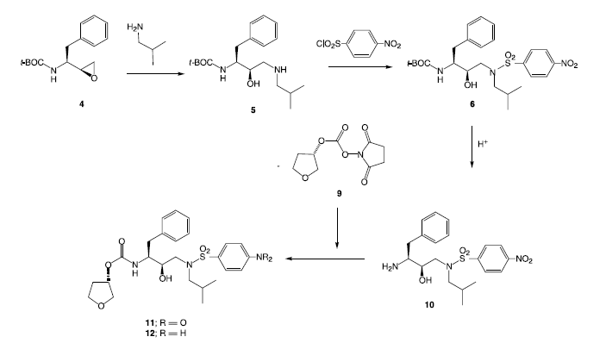
amprenavir HIV protease inhibitor
amine is protected as a carbobenzyloxy (Cbz)

Slide 2
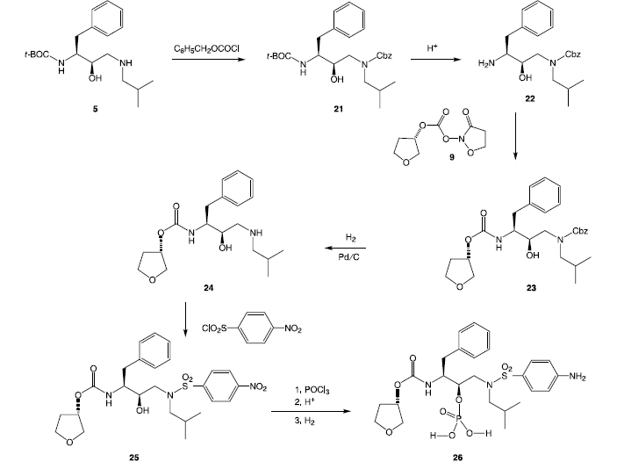
fosamprenavir

Slide 3
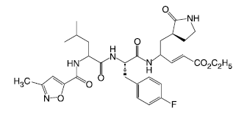
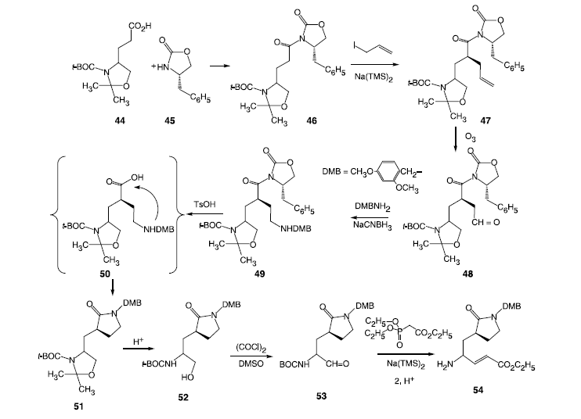

Slide 4
